Slide 1

“Cypriot Regulatory Landscape of the Fund Industry”
Mr. GEORGIOS KARATZIAS
Vice - Chairman, Cyprus Securities and Exchange Commission
0100 Conference Cyprus at Limassol Marina
13 October 2021

Slide 2

REGULATORY TIMELINE
CY Open –Ended
Undertakings for Collective Investment (UCI) Law (UCITS IV Directive)
New AIF Law (RAIFs)
Small AIFM Law (Mini-managers)
CY AIF Law
2012
2013
2014
2016
2018
2020
FUNDS LEGAL FRAMEWORK
Amendment UCI Laws (UCITS V Directive)
CY AIFM Law (AIFMD Directive)
Investment-based crowdfunding rules

Slide 3

REGULATORY UPDATES
Fund administrators
Loan Origination and Loan Participation
New Partnership Law Enactment
Crypto funds
CySEC has created a dedicated section on its website on sustainable finance

Slide 4


TYPES OF AIFS
AUTHORISED AIFs
Can be self-managed, or be managed by:
AIFMs / IFs / UCITS Management Companies /
Sub-threshold AIFM (Mini Manager)
Common Fund (externally managed AIF)
Open/closed ended
Company Limited by shares
Limited partnership
Variable Capital Investment Company
(externally or internally managed AIF)
Open ended
With Separate legal personality*
(externally or internally managed AIF)
Open/closed ended
Fixed Capital Investment Company
(externally or internally managed AIF)
Open/Closed ended
No Separate legal personality
(externally managed AIF)
Open/closed ended
Cyprus Securities and Excange Commission

Slide 5
TYPES OF AIFS
AUTHORISED AIFLNPs
Can be self-managed, or be managed by:
IFs / UCITS Management Companies
Authorised third country management company
Company with Sole Purpose the provision of portfolio management to the AIFLNP
Sub-threshold AIFM (Mini Manager)
Company Limited by shares
Limited partnership
Variable Capital Investment Company
(externally or internally managed AIFLNP)
Open ended
With Separate legal personality*
(externally or internally managed AIFLNP)
Open/closed ended
No Separate legal personality
(externally managed AIFLNP)
Open/closed ended
Fixed Capital Investment Company
(externally or internally managed AIFLNP)
Open/closed ended

Slide 6
TYPES OF AIFS
RAIFs
Can be managed by:
AIFMs
IFs
UCITS Management Companies
Sub-threshold AIFM (mini manager)
Can be managed by:
AIFMs
Common Fund
(externally managed RAIF)
Open/closed ended
Limited Liability Company with shares
Limited partnership
Limited partnership
(With separate*/without separate legal personality)
With Separate legal personality*
(externally managed RAIF)
Open/closed ended
Alternative Investment Partnership
(externally managed RAIF)
Closed ended, non liquid assets
Variable Capital Investment Company
(externally or internally managed RAIF)
Open ended
Fixed Capital Investment Company
(externally or internally managed RAIF)
Open/closed ended
No Separate legal personality
(externally managed RAIF)
Open/closed ended

Slide 7
THE MARKET
*From 30/09/2020 and onwards, the “total number of Management Companies, companies that act as Management Companies and UCIs”, includes CIFs, which had received approval from CySEC for the provision of AIF management services, based on Section 5(5)(b) of Law 87(I)/2017.
October 2021
Cyprus Securities and Exchange Commission

Slide 8
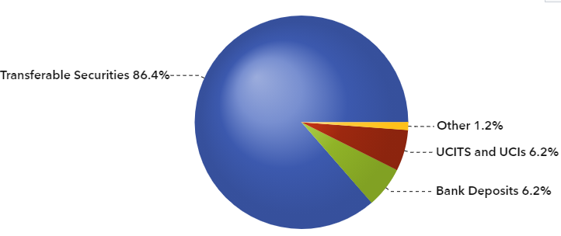
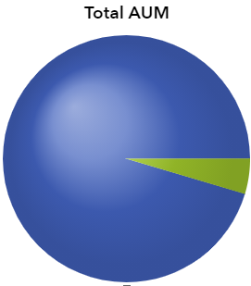

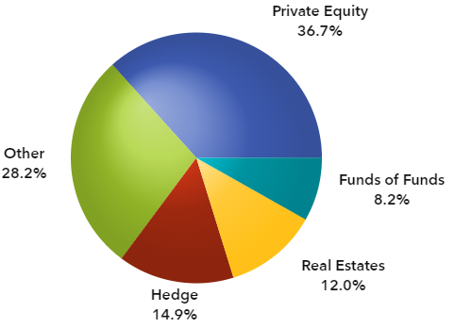

THE MARKET
UCITS Investment Strategy
AUM: €491,181,676
AIF, AIFLNP and RAIF Investment Strategy
AUM: €10,172,771,665

Slide 9

SUPERVISION
CySEC:
The pandemic brought severe stress in capital markets and in particular for investment funds focusing on liquidity issues
CySEC has closely monitored asset managers in relation to liquidity matters and looked at the activation of Liquidity Management Tools such as the suspension of redemptions
Applies a risk-based approach to supervision
Provides guidance and clarifications as to the interpretation of the applicable regulatory framework

Slide 10


